Slide 1
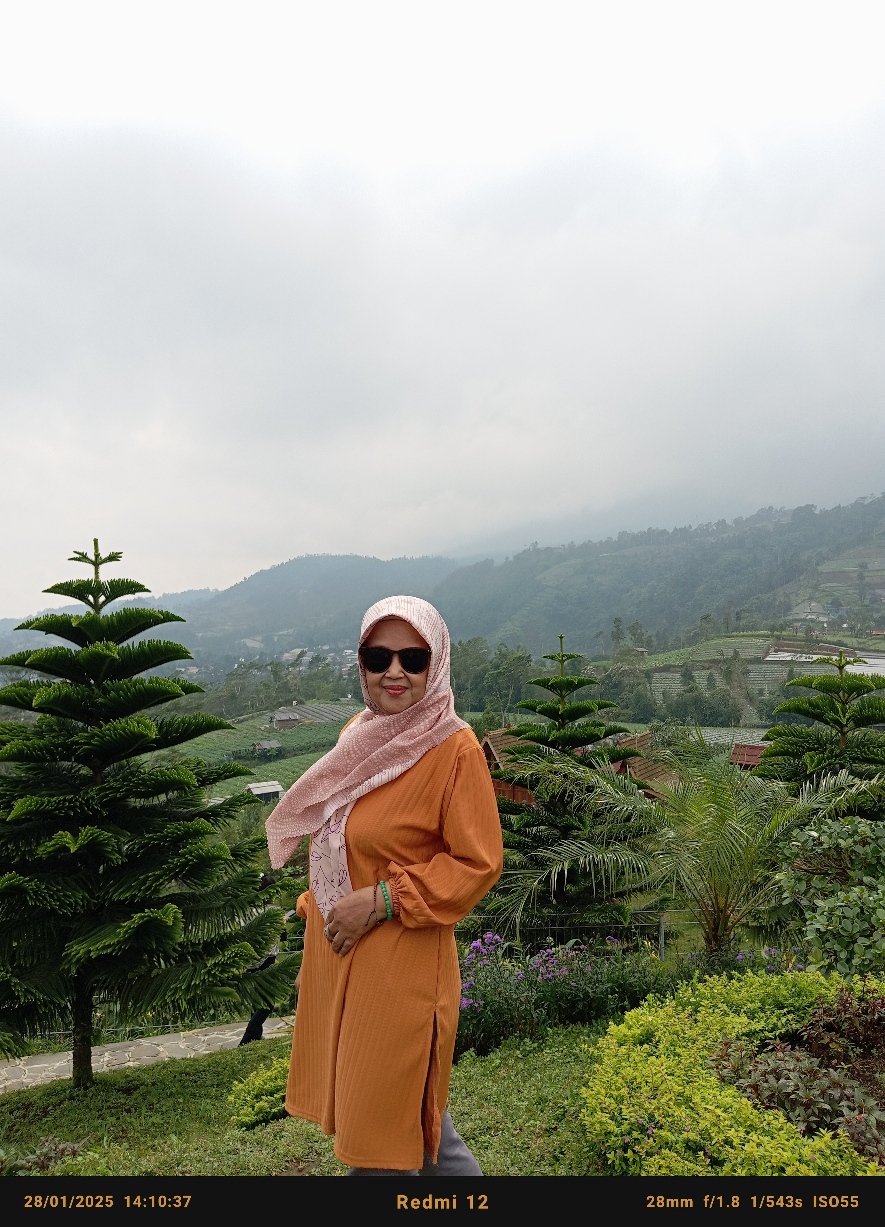


SMP Negeri 1 Turen
Jl.P.Sudirman 1 A Turen
Borcelle High School
By : Inis Unsaroh, S. Pd
WORKSHEET
ADVERTISEMENT

Slide 2
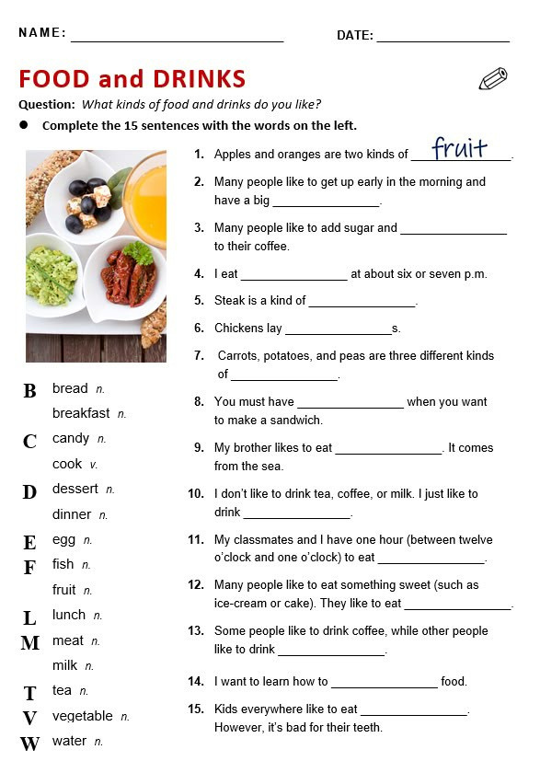

Slide 3
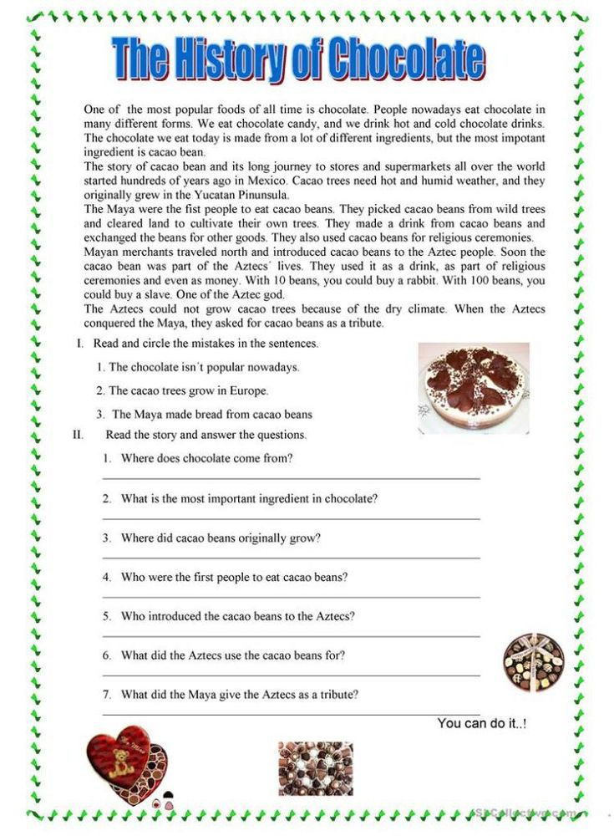

Slide 4
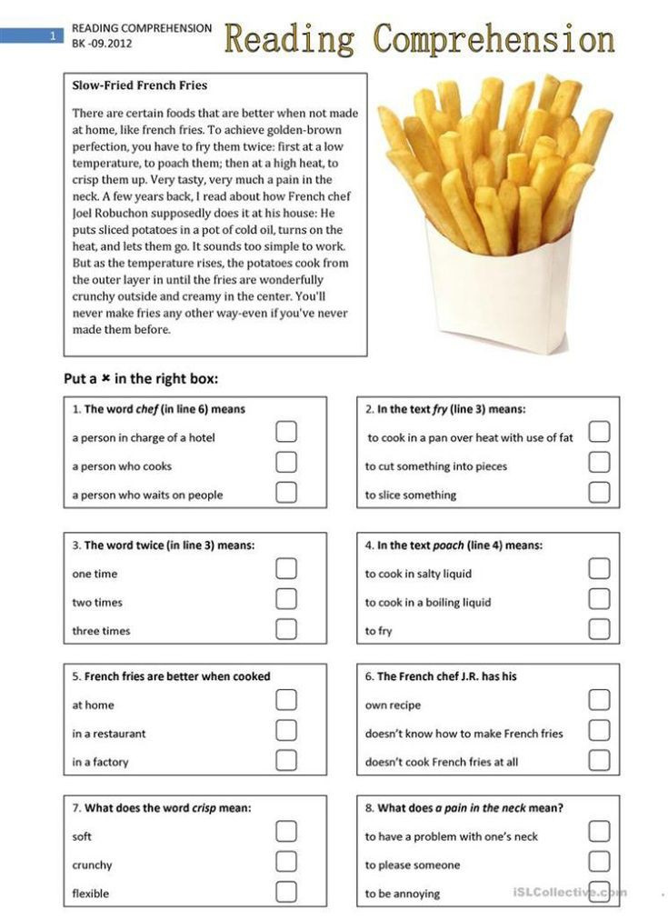

Slide 5
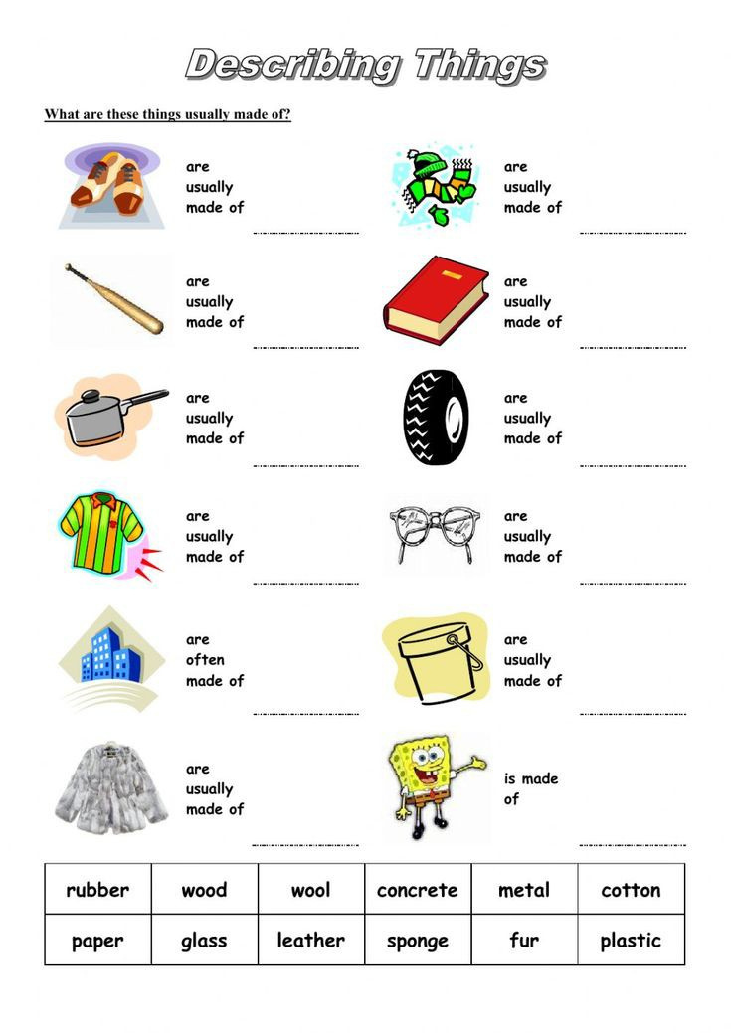

Slide 6
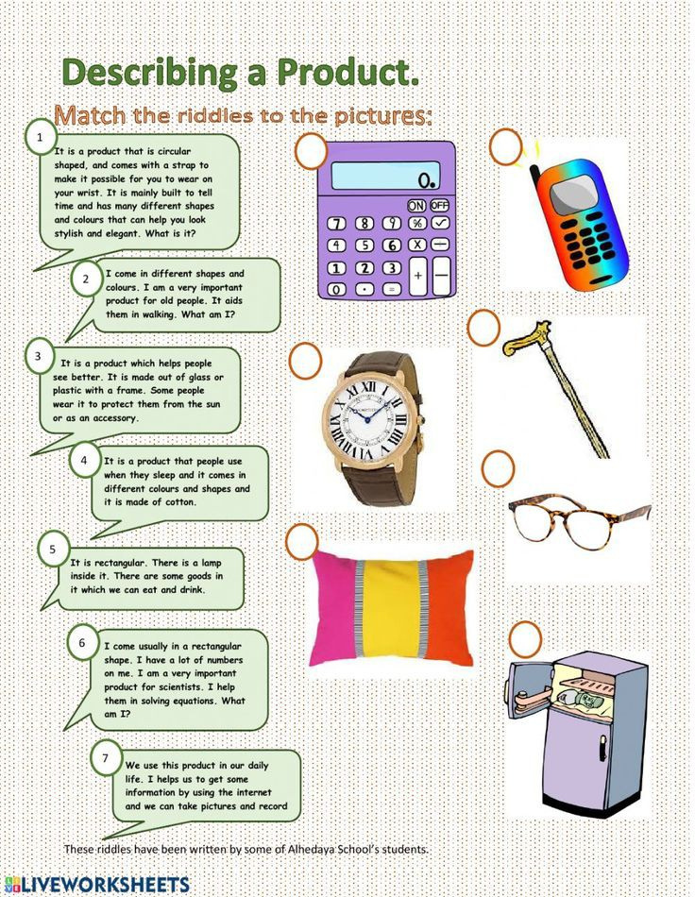

Slide 7
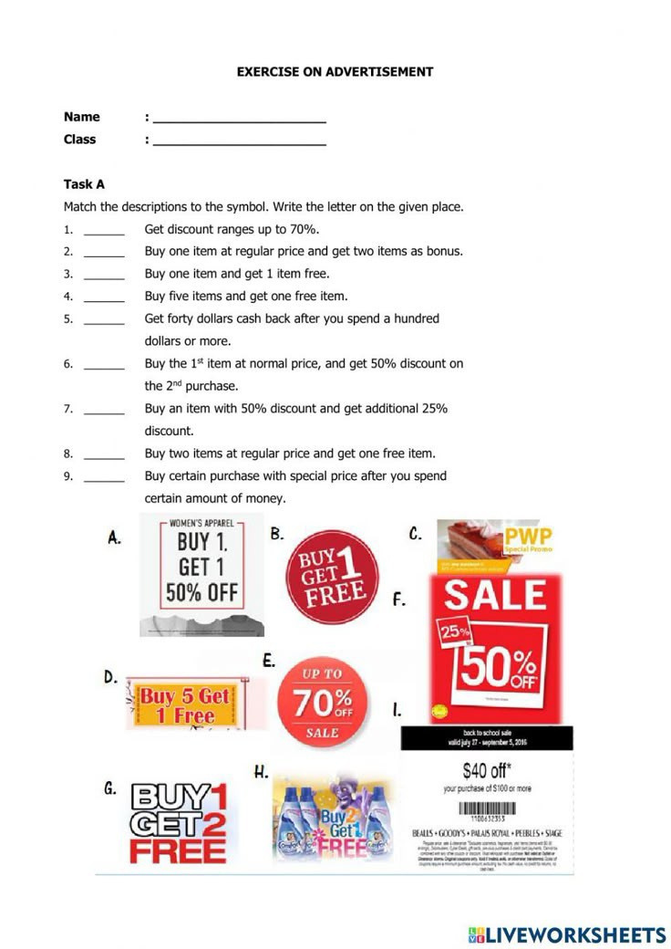

Slide 8
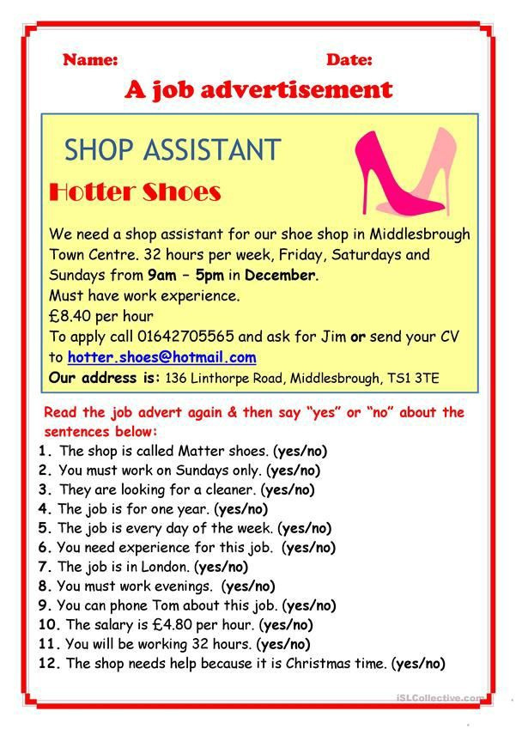

Slide 9
